Slide 1
SPORTEVE – A WEB APPLICATION FOR ORGANIZING SPORTING EVENTS
Fakultet Elektrotehnike i Računarstva
Mentor: Doc. Dr. Sc. Marina Bagić Babac
Author: Jura Darko Šlehan

Slide 2
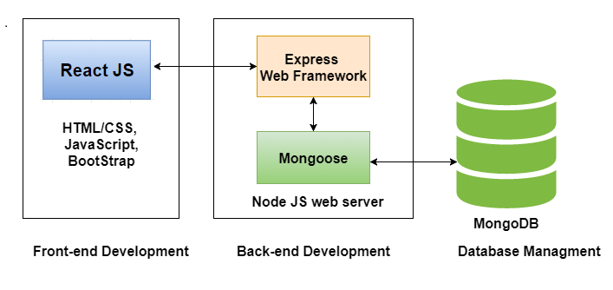
System Architecture
Front-end
Back-end
Database

Slide 3




Technologies
ReactJS
NodeJS
ExpressJS
MongoDB
Mongoose

Slide 4
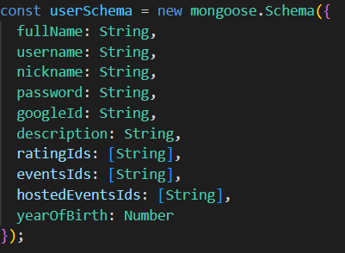
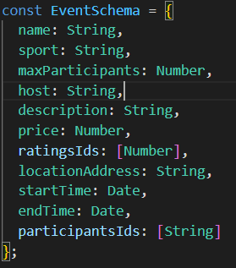
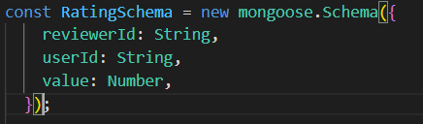
Database
NoSQL
MongoDB and Mongoose
Users, Events and Ratings

Slide 5
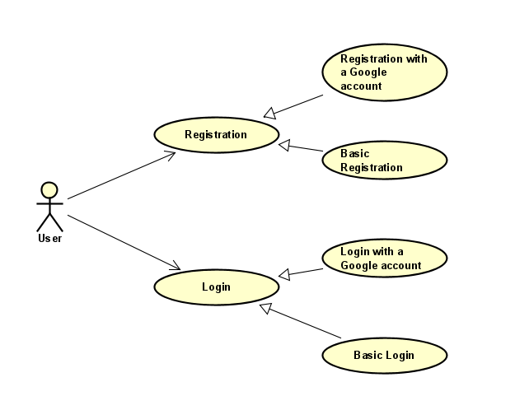
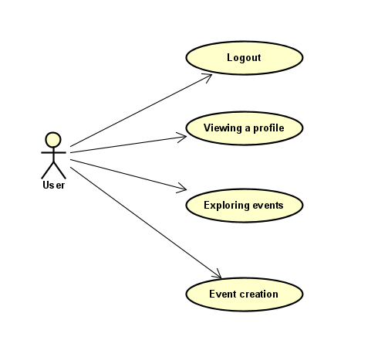
Main functionalities
Registration/Log-in
Event exploration
Creating a new event
Managing your event
Joining/canceling events
Viewing profiles

Slide 6
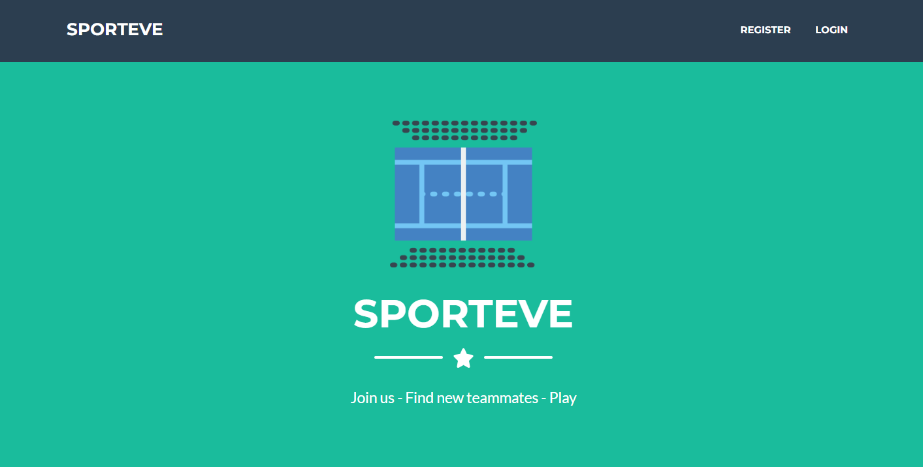
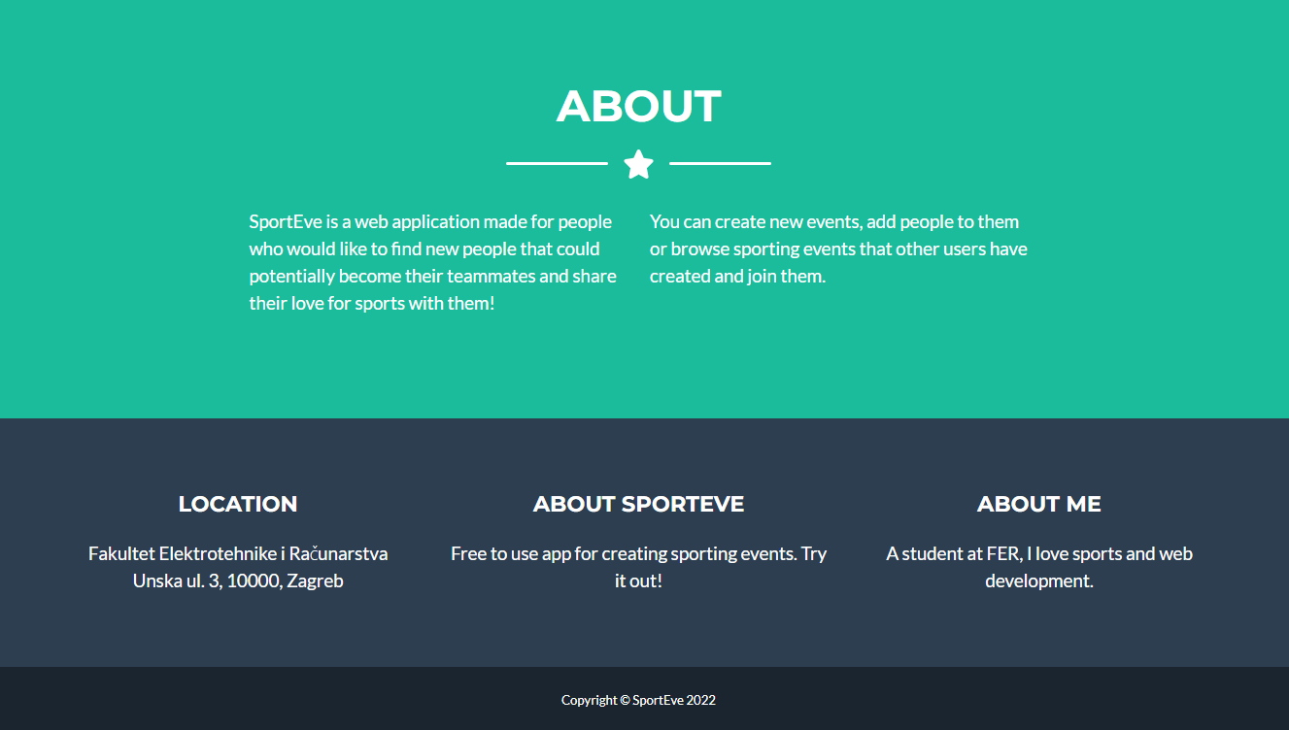
Landing page

Slide 7

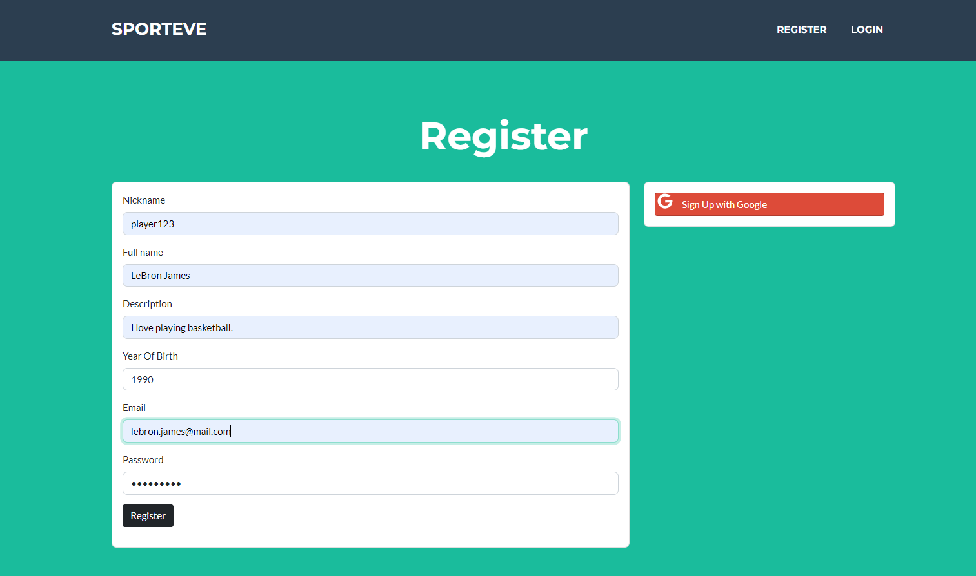
Registration
Creating a new account
2 options:
Google account
Email and new password

Slide 8
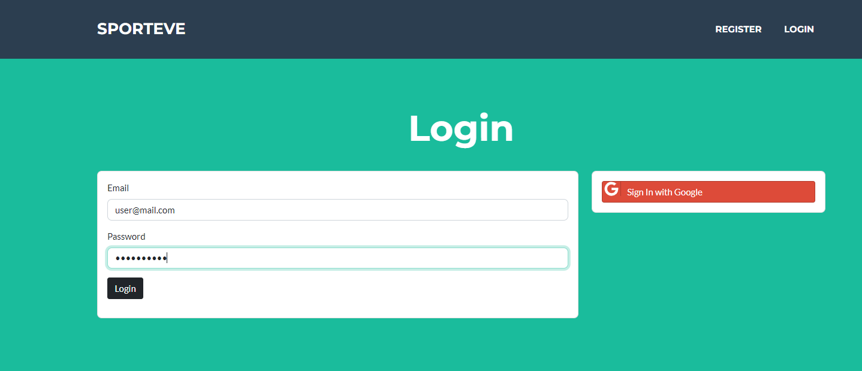
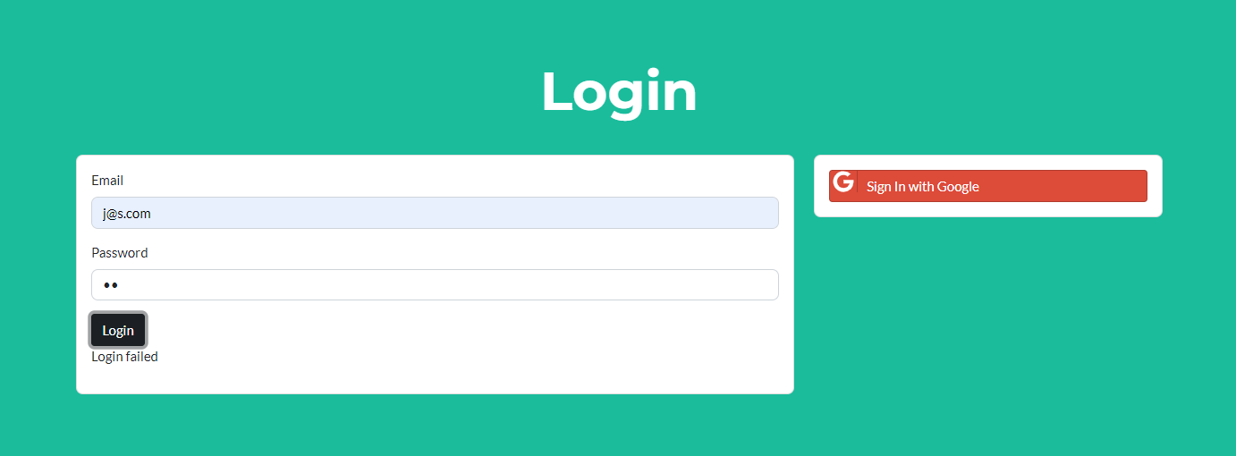
Logging-in

Slide 9
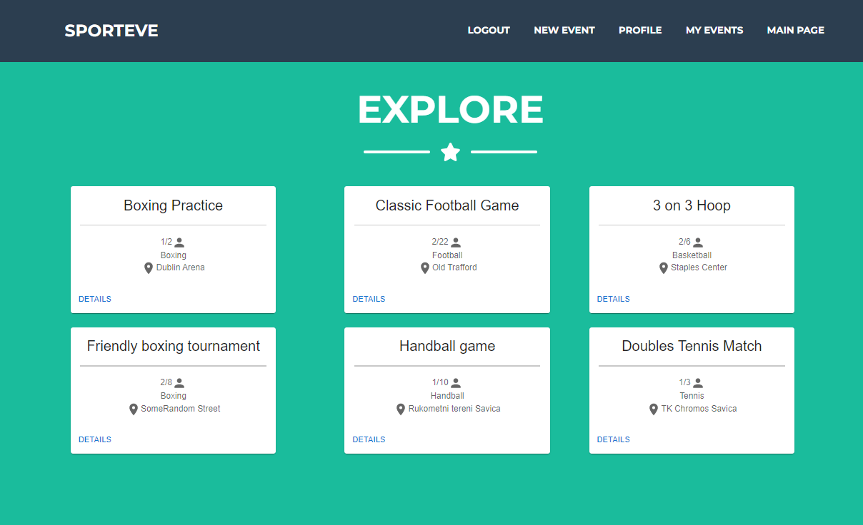
Navigation

Slide 10
Main page
Exploring new events
Basic information about every event
Details for more information

Slide 11
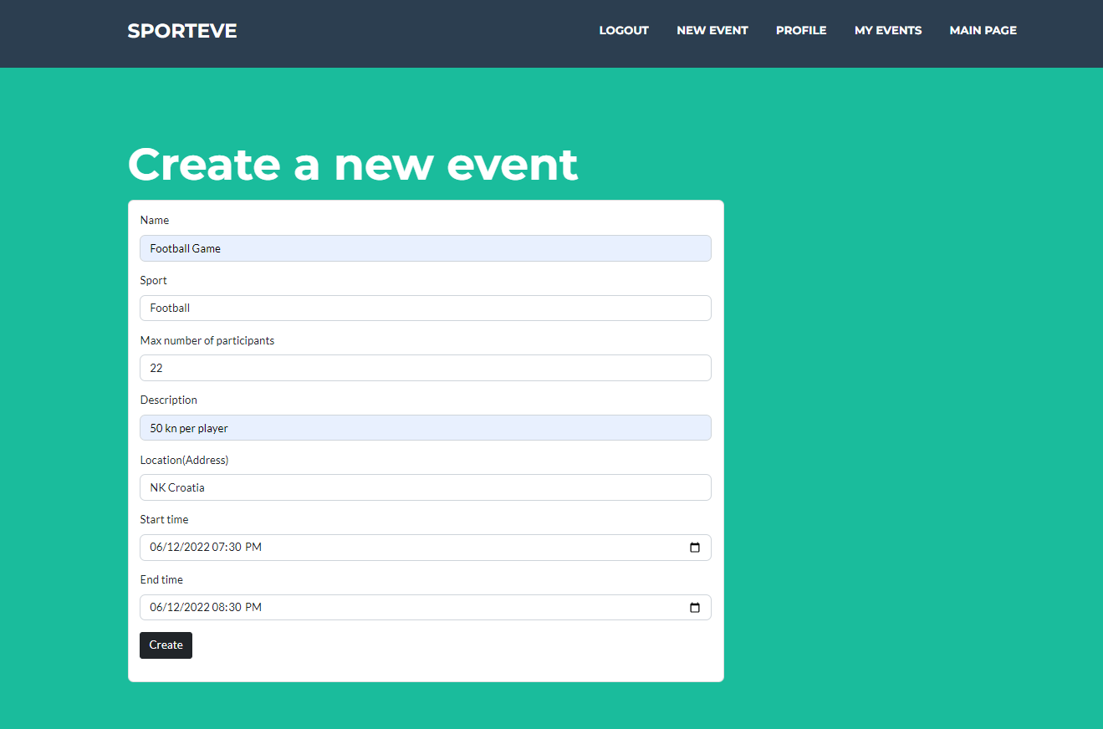
Creating a new event

Slide 12
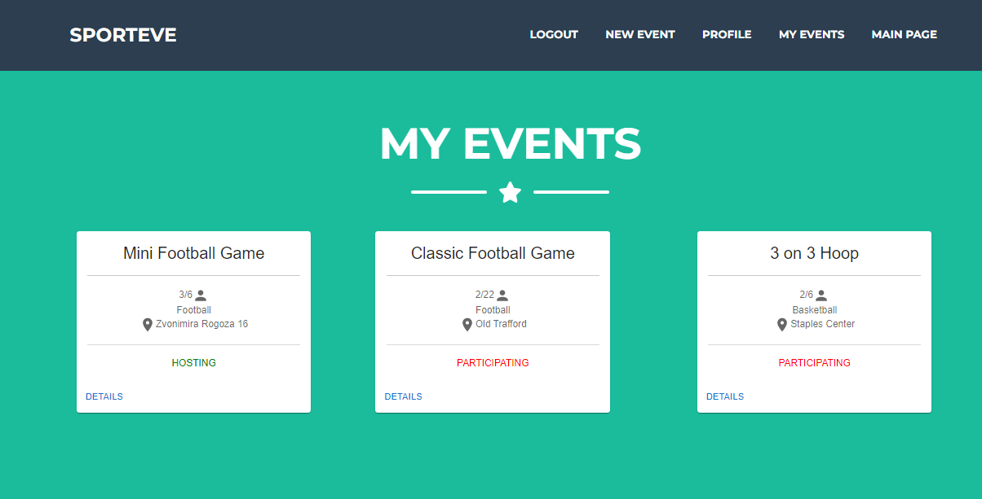
My events
Current user’s events
Hosting or participating

Slide 13
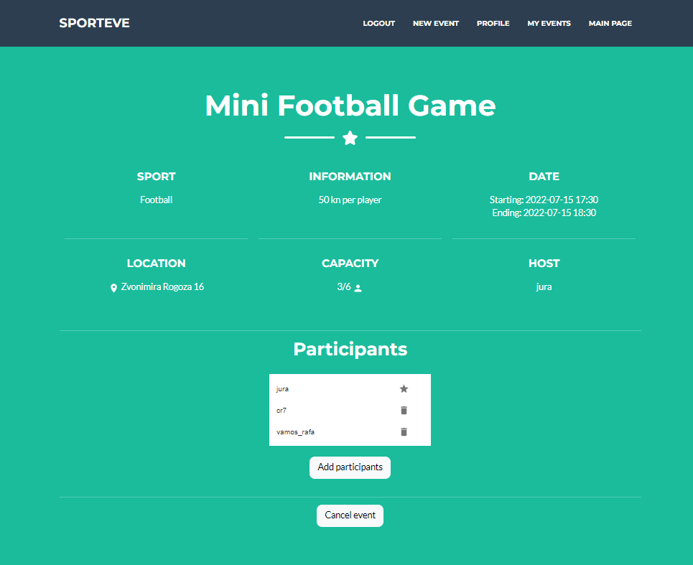

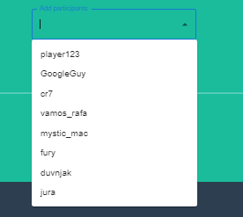
Event page – host view

Slide 14
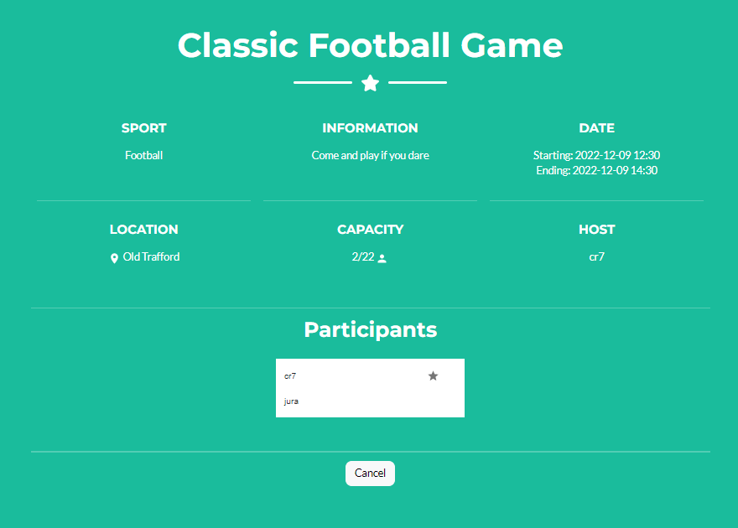
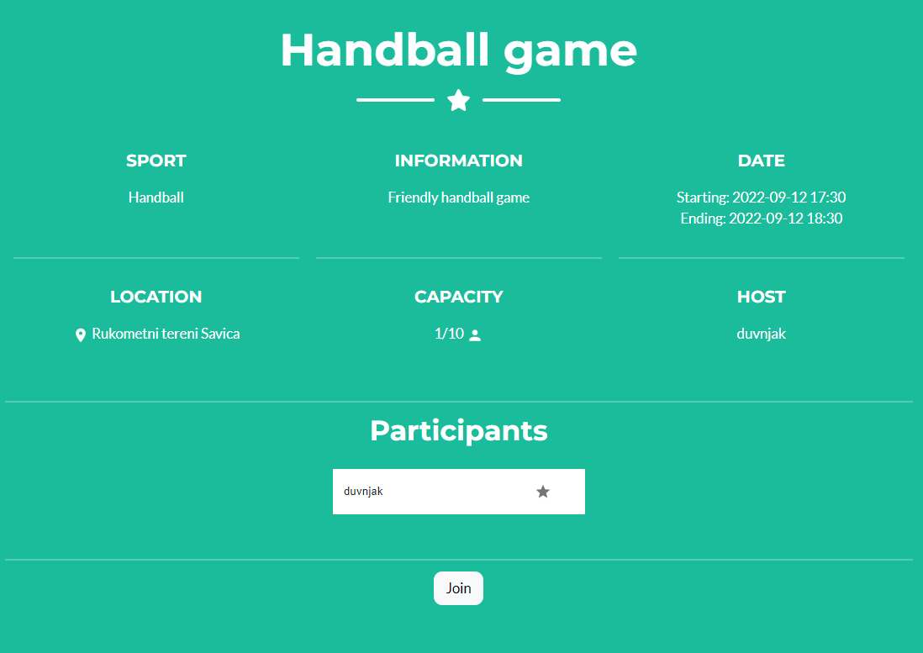
Event page – other users
Participating
Not participating

Slide 15
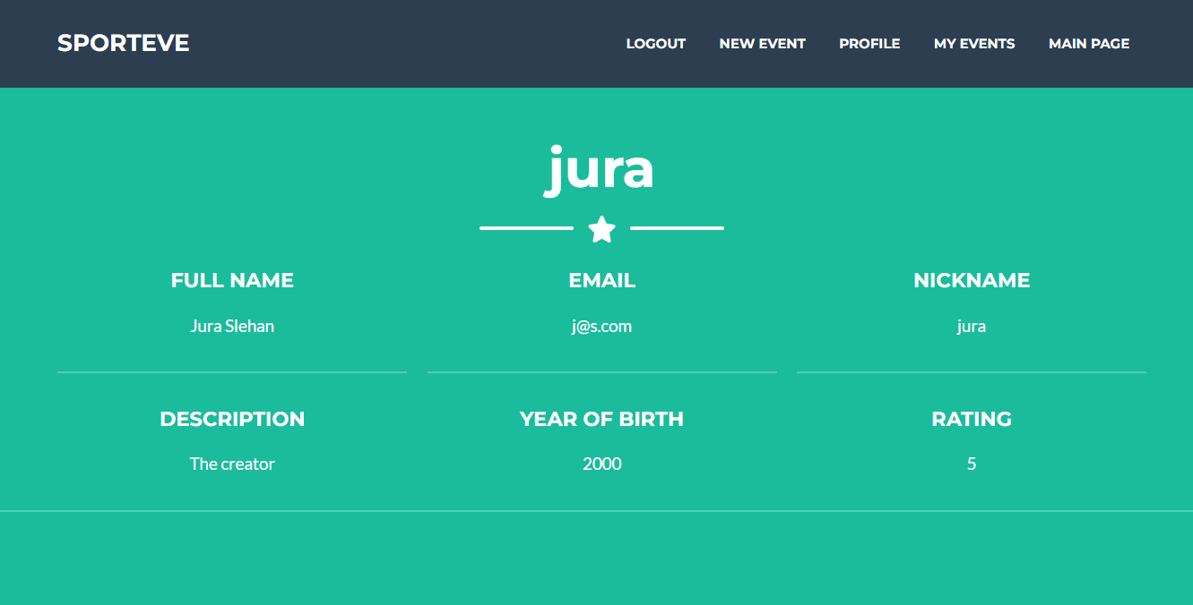
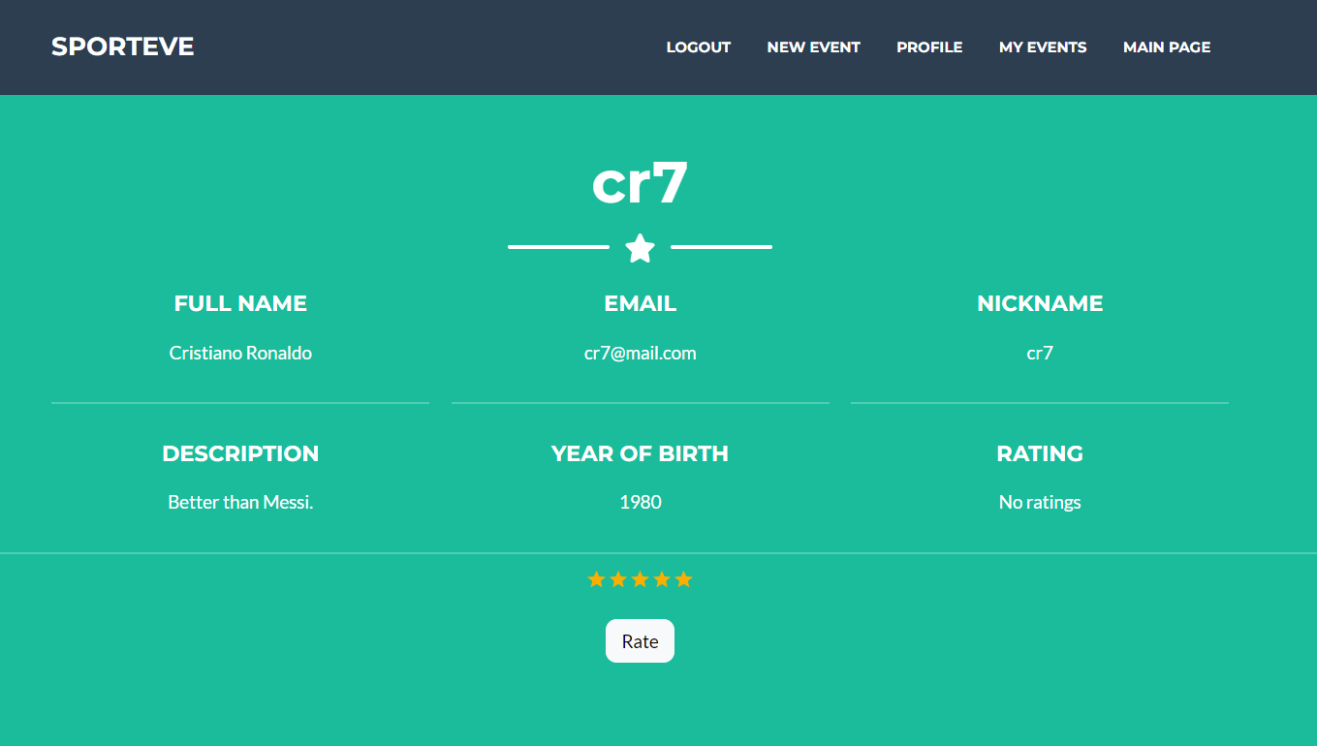
Viewing a user

Slide 16
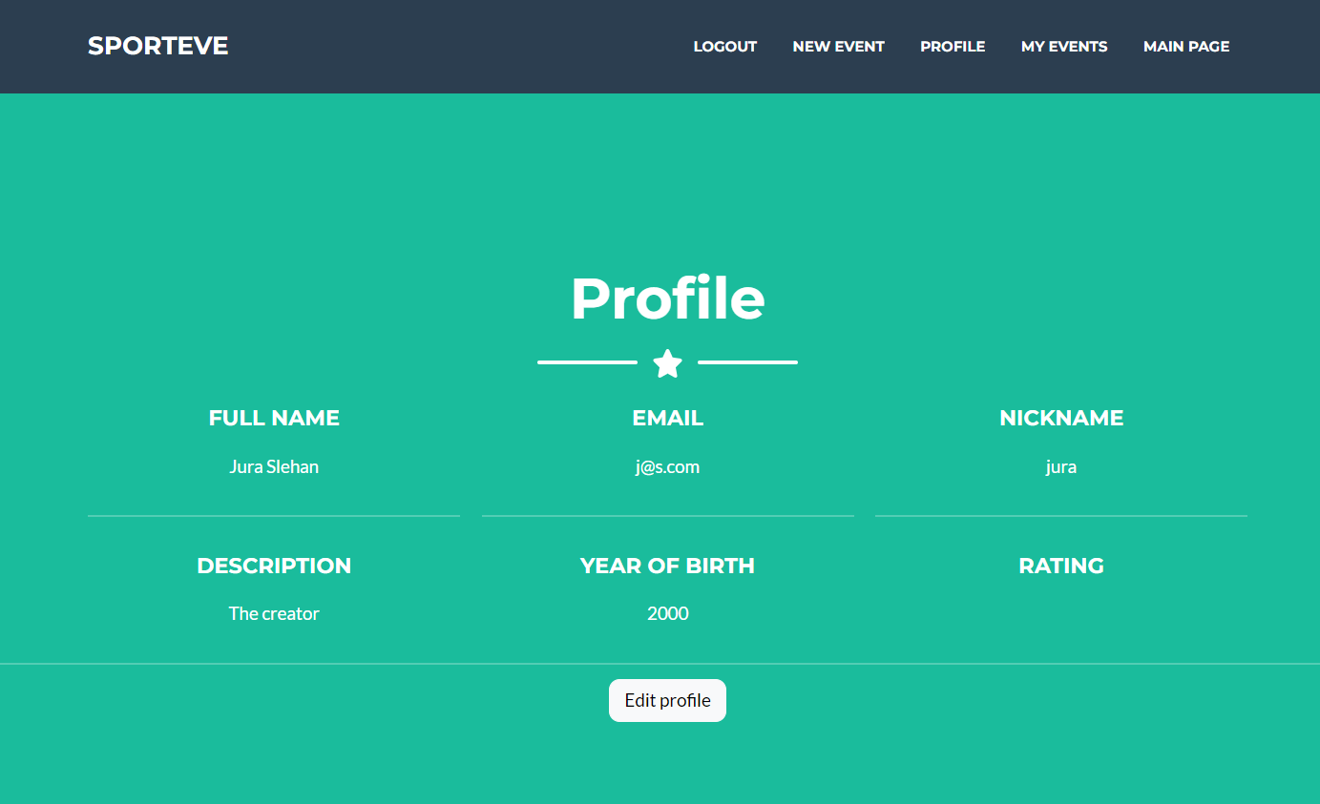
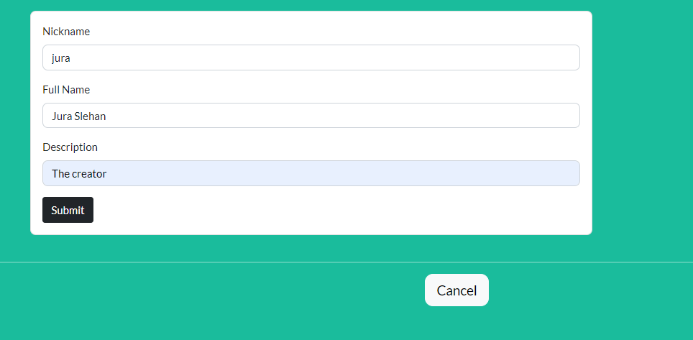
Profile

Slide 17
Conclusion
Organize events easier
Find new people
Enjoy playing different sports

Slide 18
Thank you!

